Slide 1

Data-Driven and Artificial Intelligence(AI) Approach for Modelling and Analyzing Healthcare Security Practice
By: Prosper K. Yeng:
Norwegian University of Science and Technology
University of Tromsø, The Arctic University of Norway

Slide 2
Outline
Motivation
Background
Objective/Research Question
Discussion

Slide 3
Security Practices
McCormac, A., et al. 2017
Security Practices includes security measures being adopted by healthcare staff in their IS usage in order to prevent compromising the CIA of resources
Security practices:
internet use,
email use,
social media use,
password management,
incident reporting,
information handling
mobile computing
Etc.

Slide 4
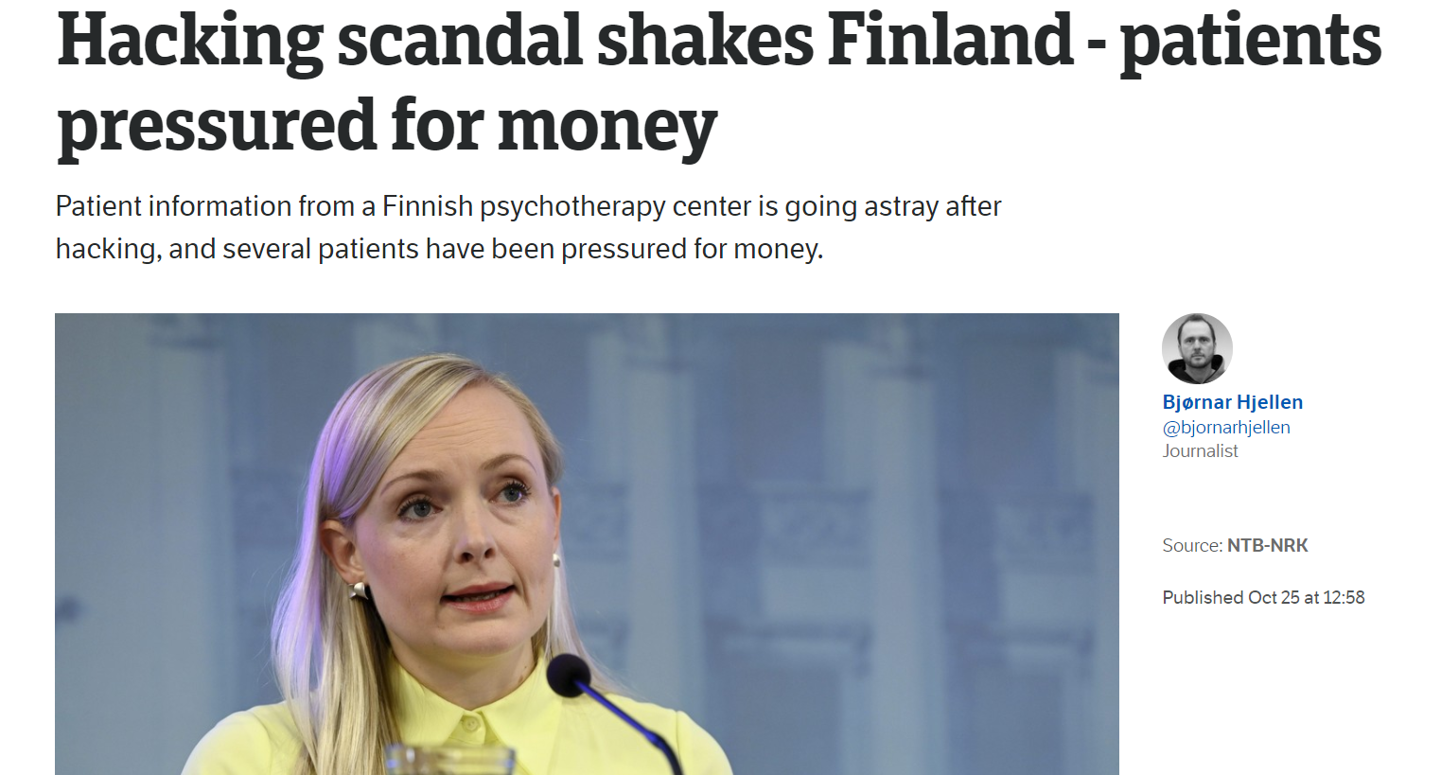

Slide 5
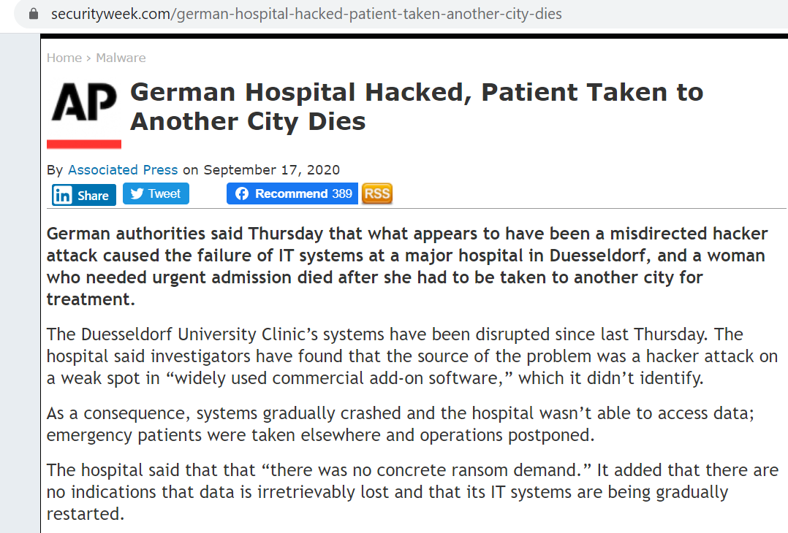

Slide 6
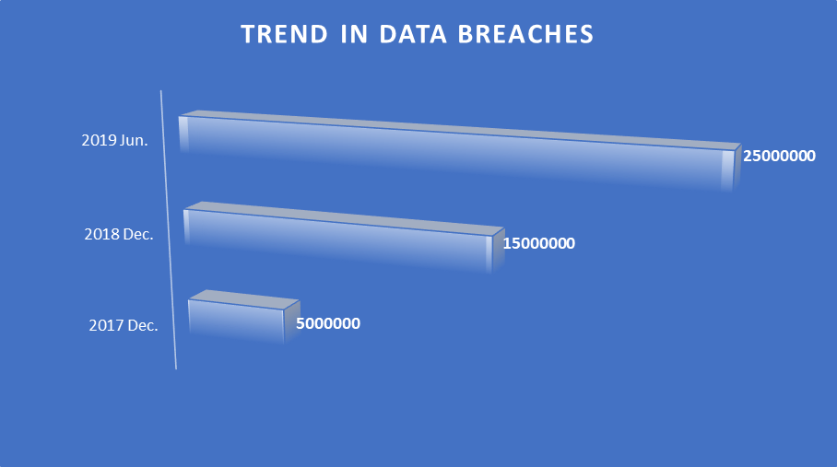

Slide 7
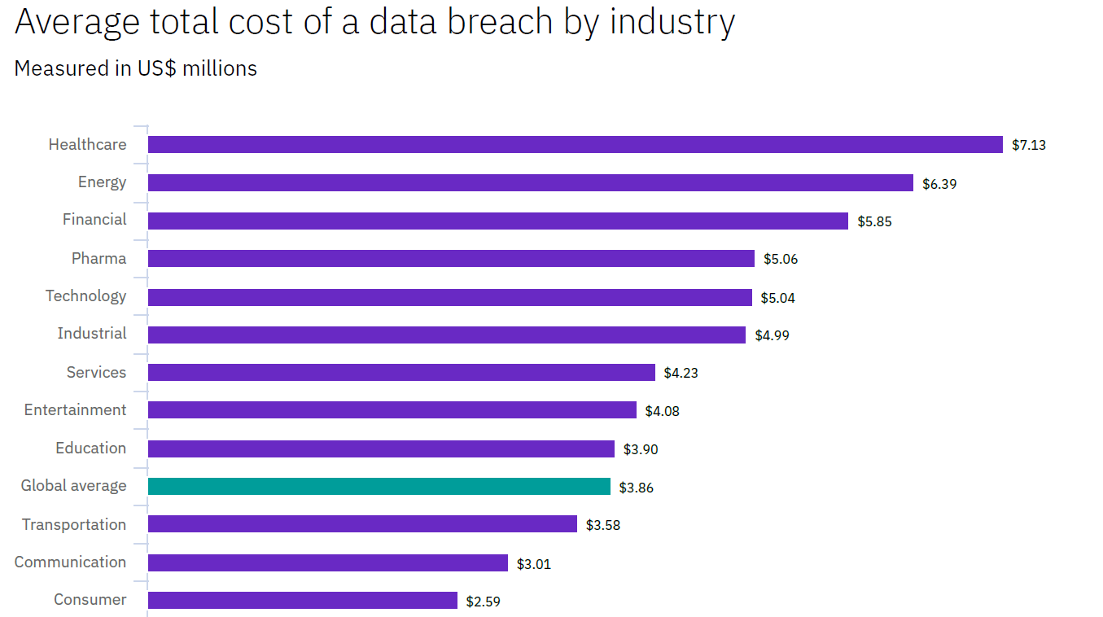

Slide 8
Data breaches amidst Technological counter measures
Human factors?

Slide 9
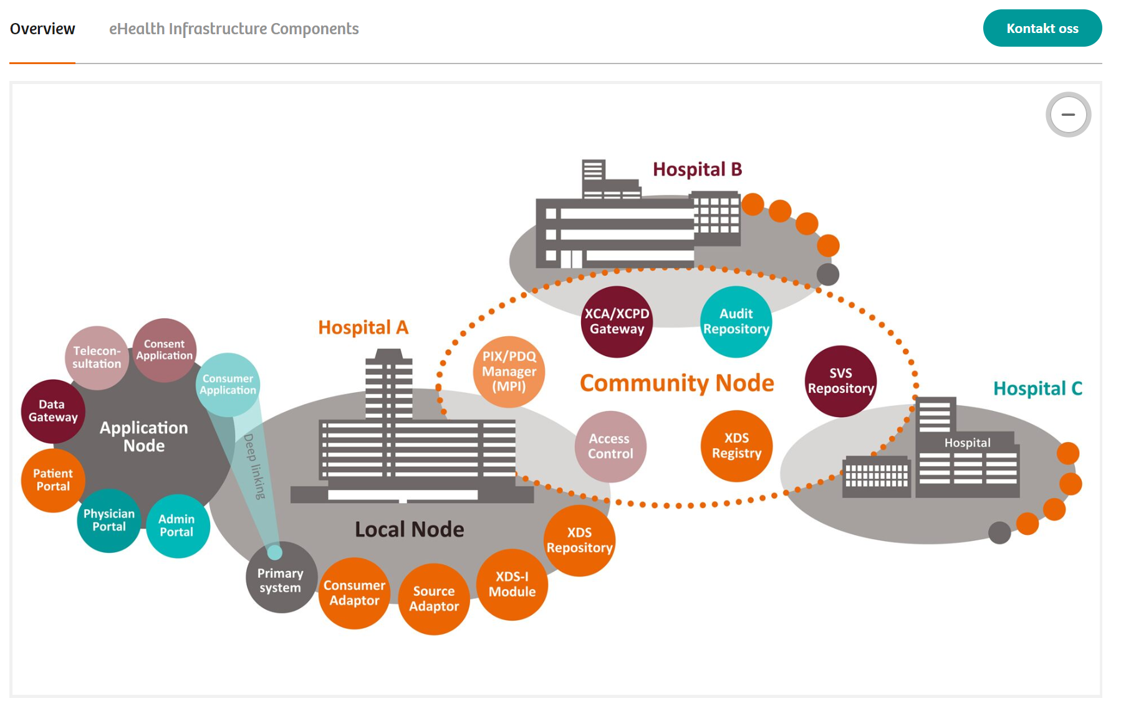
More attention on tech. measures than the human firewall!
Norwegian eHealth infrastructure(Siemens-healthineers, 2018)
security governance configuration,
security planning and policies,
risk management,
And other technology controls
Firewalls
DMZs
IDS/IPS
Antivirus
Other Technologies

Slide 10

In summary
Healthcare staffs’ Concious care practice
Technological Measures

Slide 11
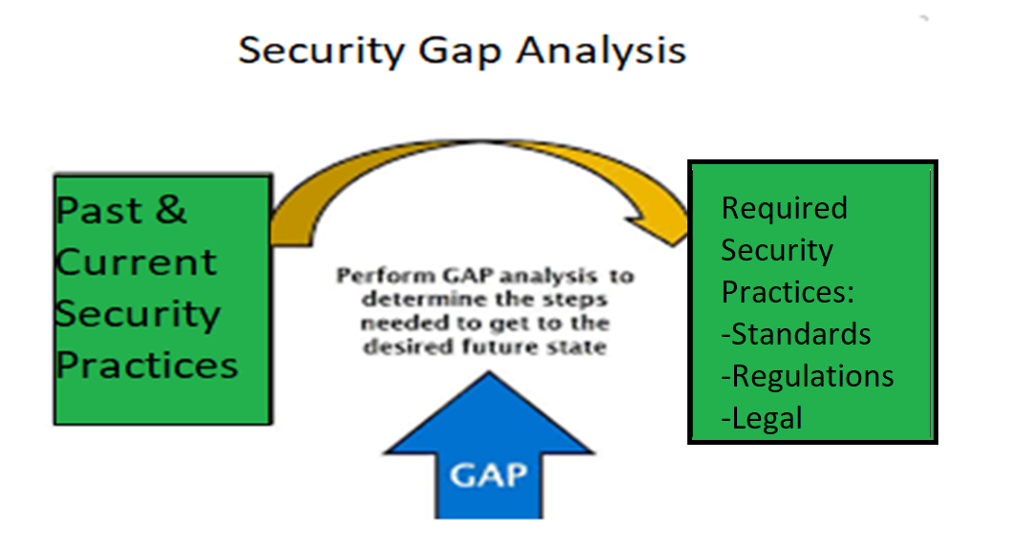
General Goal of HSPAMI

Slide 12
Literature Survey
Framework/Study | HSPAMI Study areas addressed | Approach
A conceptual framework [11] | Users perception | Qualitative, Quantitative
Framework for healthcare information assurance policy and compliance[12] | Users perception | Qualitativy
Security practices of healthcare staffs in real clinical setting.[15] | Users perception, Social Control | Survey with questionnaires
Protection Motivation Theory (PMT) and Theory of Planned Behavior (TPB)[16] | Users perception | Survey with questionnaires
Conceptual Framework [19] | Big data analysis | Comparison of input data with known attack signatures
Network anomaly detection sensor (SNAD)[20] | Big data analysis | Comparison of input data with established pattern
Local Outlier Factor (LOF) in Electronic Patients Records [21] | Big data analysis | KNN
Cyberattacks Against U.S. Healthcare Systems[22] | Social Engineering | Reviews of phishing attacks
Evaluation of a mandatory phishing training program for high-risk employees at a US healthcare system[24]. | Social Engineering | Phishing Attack-Defense simulation
Assessment of Employee Susceptibility to Phishing Attacks at US Health Care Institutions[25] | Social Engineering | Phishing Attack-Defense simulation

Slide 13
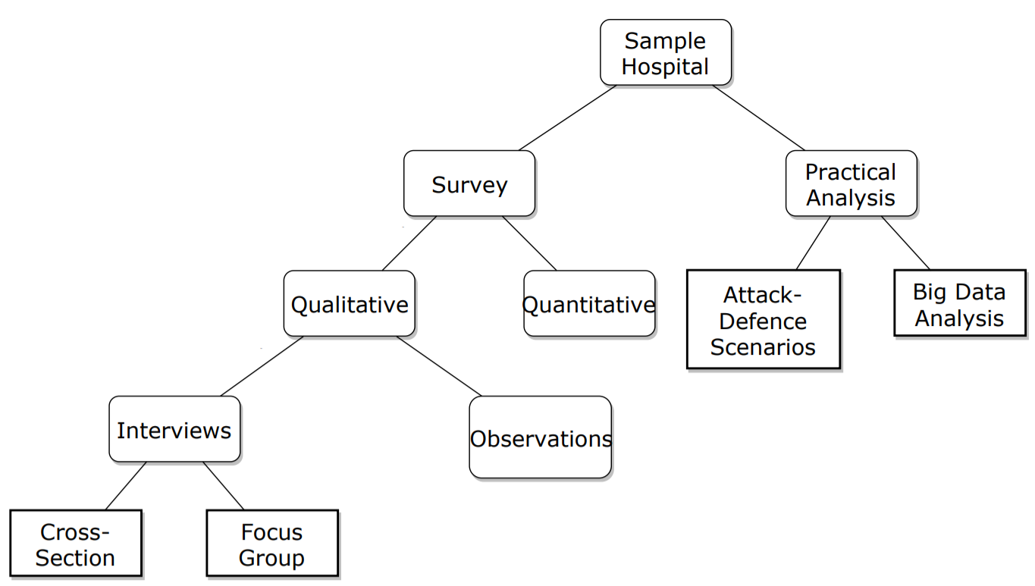
Study Structure

Slide 14
Data Driven and AI Approach

Slide 15
Access Control (AC) in Healthcare
EMR systems incorporate AC, users are often permitted to “break the glass” to ensure patient care is not disrupted

Slide 16
Security requirement in EHR
Patients records need to be accessed for therapeutic purposes
Access must be granted following a specific decision based on planned for the medical treatment of the patient.

Slide 17
The necessary measures should be provided to enable access
to patient information when necessary (Eg In self-authorization or ”break the glass” scenarios).
However, misuse of self-authorization needs to be handled as a breach
EHR with permission functions must record rights to read, register, correct, erase, and/or block personal health

Slide 18
The logs must contain the following [12]–[14]:
unique identifier for the authorized user
The role of the authorized user at the time of access
Organisational affiliation
Type of data to which access has been gained

Slide 19
Hypothesis?

Slide 20
Data sources which are created by healthcare staffs’ like:
access control logs of EHR,
network logs
operating systems logs
other histories of their practices
can be reconstructed to form their unique individual security
behavioral profile.

Slide 21
EMR systems incorporate AC, but users are often permitted to “break the glass” to ensure patient care is not
But the requirement is that broken glass events need to be reviewed by administrators, This is possible when the number of escalations is small.

Slide 22
Is this often the case? (Expected Fewer logs for manual investigation)

Slide 23
A study in Norway, provides showed that idea can fial [Rostad and Nytro 2006]:
In one month, 50% of approximately 100,000 patients’ records were accessed via break-the glass
By 45% of approximately 12,000 users,
leading to over 290,000 incidents,
which corresponded to around 17% of all accesses.

Slide 24
How possible can 290,000 records be manually reviewed?
This caseload is greater than any EMR administrator or healthcare privacy official can handle

Slide 25
To this end, various efforts are being adopted to minimize
the data breaches in healthcare which includes a comprehensive
approach involving modeling and analyzing healthcare
security practice in the context of big data [10].

Slide 26
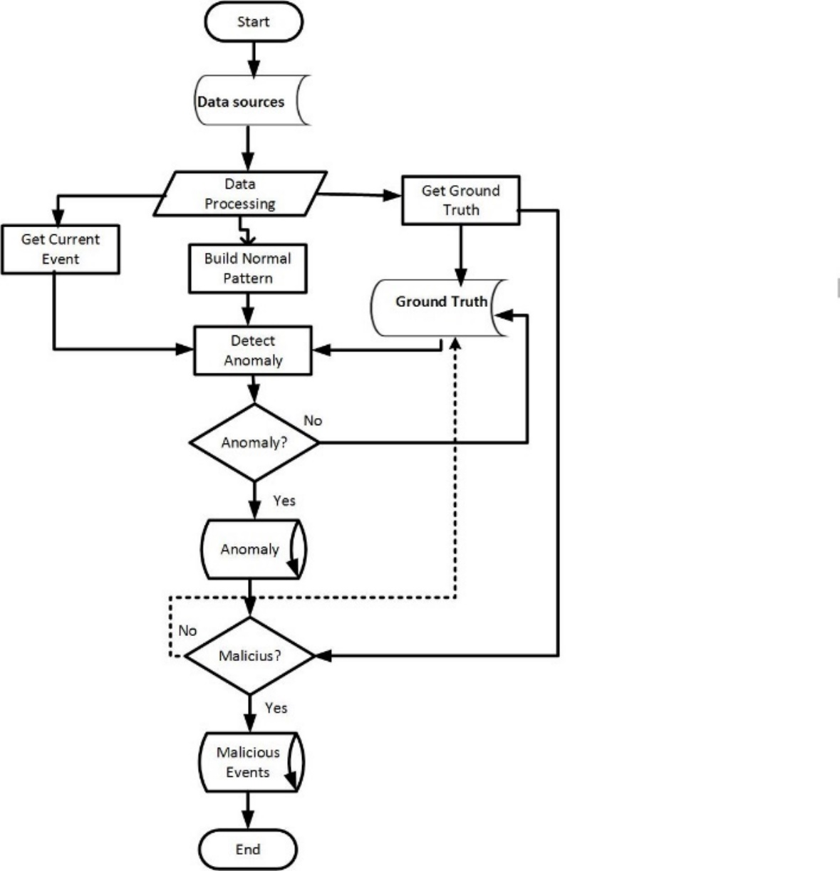
How can security practice be analyzed in the context of big data?

Slide 27
Simulation

Slide 28
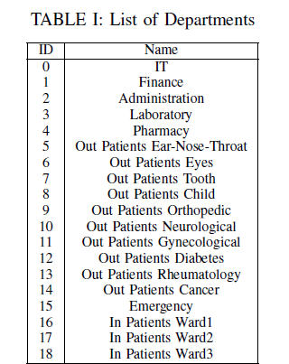

Slide 29
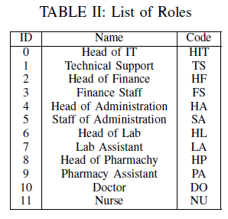

Slide 30
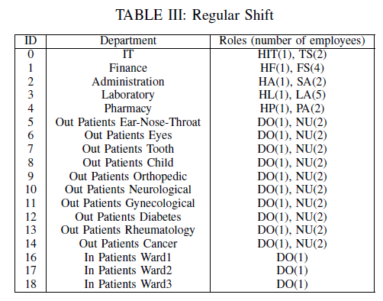
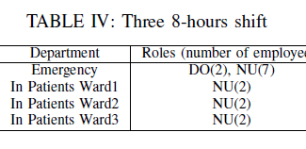

Slide 31
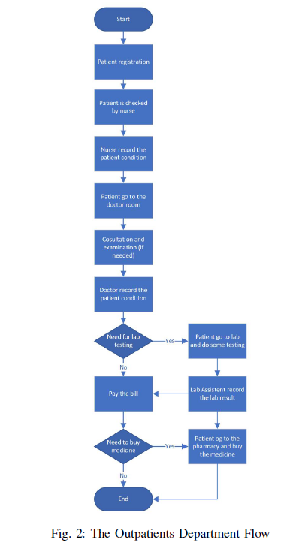

Slide 32
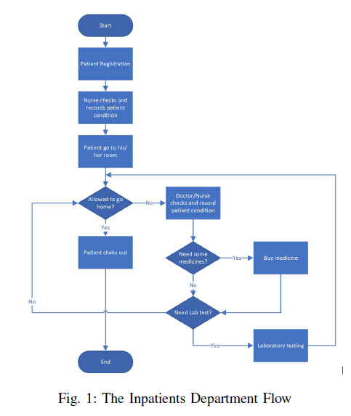

Slide 33
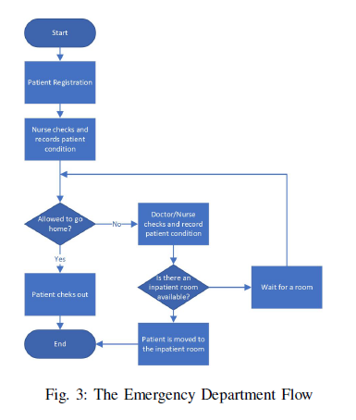

Slide 34
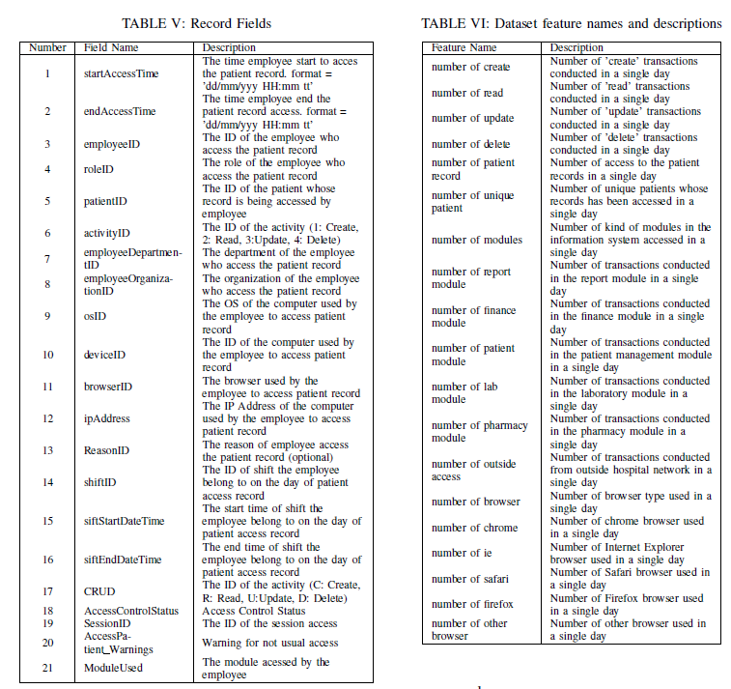

Slide 35
Normal data
The normal data are all the instances in which all access logs are in line with the roles and flows.

Slide 36
Abnormal data
All the instances had at least one fraudulent log access in a single day:
Attackers are assumed to have compromised some users credential and use it to access patients records (e.g. identity theft).
The attacker will access more data than legitimate users
Sometimes not follow the flows.
Accessing patients outside their sift, using different browser,
accessing modules outside their roles

Slide 37
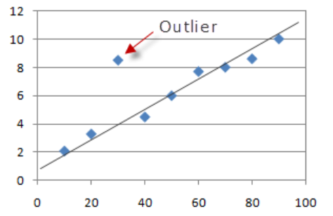

Slide 38
Reference
Foroughi, F. and P. Luksch. Observation Measures to Profile User Security Behaviour. in 2018 International Conference on Cyber Security and Protection of Digital Services (Cyber Security). 2018.
ISO, ISO 27799:2016(en), Health informatics Information security management in health using ISO/IEC 27002. 2016.
Nurse, J.R.C., et al. Understanding Insider Threat: A Framework for Characterising Attacks.IEEE Security and Privacy Workshops. 2014.
Boddy, A., et al. A Study into Detecting Anomalous Behaviours within HealthCare Infrastructures. in 2016 9th International Conference on Developments in eSystems Engineering. 2016.
Walker-Roberts, S., M. Hammoudeh, and A. Dehghantanha, A Systematic Review of the Availability and Efficacy of Countermeasures to Internal Threats in Healthcare Critical Infrastructure. IEEE Access, 2018. 6: p. 25167-25177.
e-helse, D.f. Implementation of GDPR in health care sector in Norway. 2019; Available from: https://ehelse.no/personvern-og-informasjonssikkerhet/eus-personvernforordning/implementation-of-gdpr-in-health-care-sector-in-norway.
LOVDATA, Lov om behandling av helseopplysninger ved ytelse av helsehjelp (pasientjournalloven) - Kapittel 3. Taushetsplikt, innsynsrett og rett til å motsette seg behandling av helseopplysninger. 2019.
omsorgsdepartementet, H.-o., Act of 18 May 2001 No. 24 on Personal Health Data Filing Systems and the Processing of Personal Health Data (Personal Health Data Filing System Act), in 042041-990016. 2006, regjeringen.no.
Supervision, N.B.o.H., The Act of 2 July 1999 No. 63 relating to Patients’ Rights (the Patients’ Rights Act) in 63. 1999.
Neuhaus, C., A. Polze, and M. M R Chowdhuryy, Survey on Healthcare IT Systems: Standards, Regulations and Security. 2011.
GDPR.Report, Businesses at risk due to unidentified network traffic according to global survey - GDPR.Report. 2018.
Hipaa Journal, Healthcare Data Breach Statistics. 2019.
Norwegian Centre for E-health Research. Diabetesdagboka.no. 2018; Available from: http://www.diabetesdagboka.no/en/.
EUR-Lex, The European Parliament and the Council of the European Union, Regulation (EU) 2016/679, EU, Editor. 2016.
Pedersen, S. and G. Hartvigsen, Lessons learned from 25 years with telemedicine in Northern Norway. 2015

Slide 39

Thank You For Your Attention!
Questions?
PROSPER K. YENG
PhD. Candidate
Norwegian University of Science and Technology
E-mail: Prosper.Yeng@ntnu.no

